Slide 1
Presented By:
Student Name: Y R Kiran kumar
Intern ID : BOV26O-0520
Email : yrkirankumar18@gmail.com
Organization : Brainovision Solutions India Pvt. Ltd.
Internship Domain: GEN AI AND AGENTIC AI
Certificate Generation System

Slide 2
Problem Statement
Manual certificate generation is repetitive and time-consuming.
Formatting each certificate individually increases the chance of errors.
Managing certificates for a large number of participants is difficult.
Traditional certificates lack an easy verification mechanism.
Organizations require a faster, secure, and automated solution.

Slide 3
Objectives & Proposed Solution
Objectives
Automate certificate generation.
Support bulk certificate creation using CSV/XLSX files.
Generate professional PDF certificates.
Maintain certificate history in a database. Provide an easy-to-use dashboard for administrators.
Proposed Solution
Develop a Flask-based web application that automates the complete certificate generation process, stores participant records, generates QR-enabled certificates, and allows secure certificate verification.

Slide 4
Technologies Used & Challenges
Technologies Challenges
Python & Flask Data Validation
SQLite PDF Generation
ReportLab Database Management
Bootstrap Responsive UI
QR Code

Slide 5
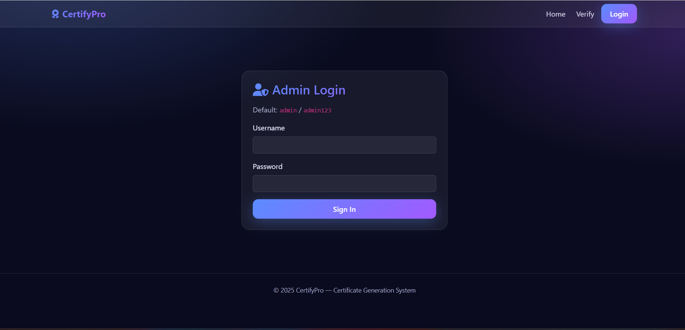
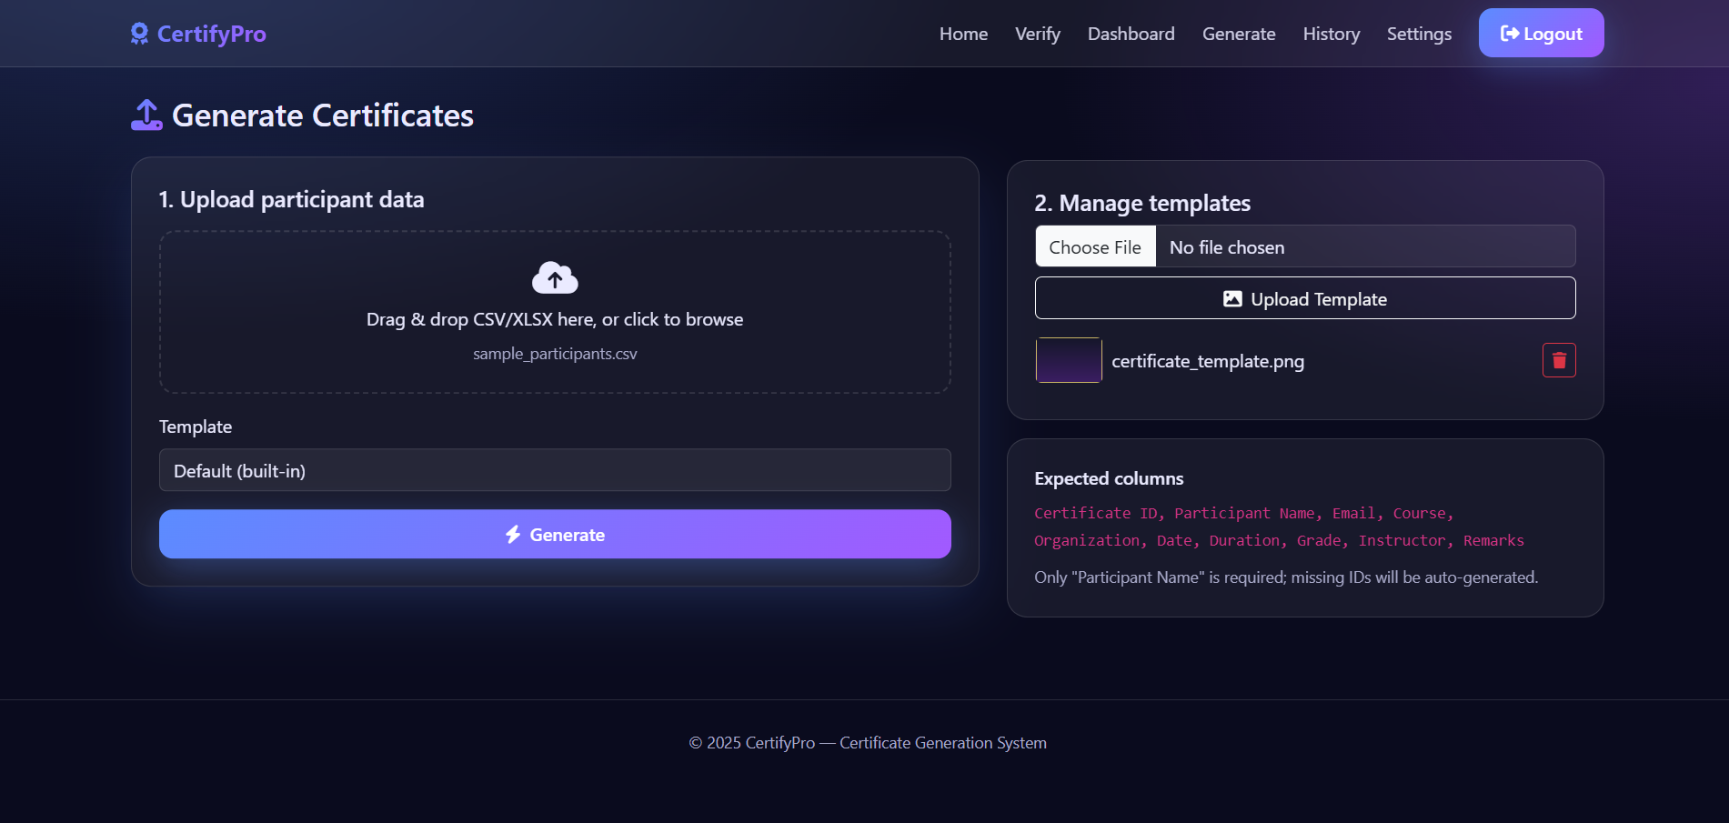
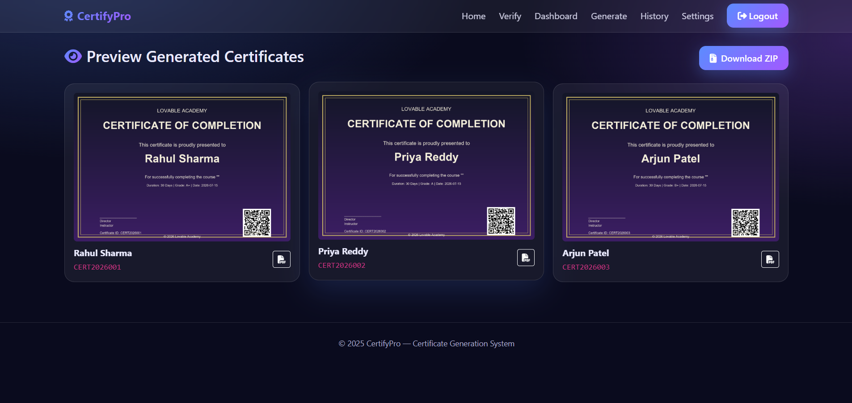
Outcomes
Outcomes
Successfully automated certificate generation.
Reduced manual effort and processing time.
Improved accuracy and consistency.

